Slide 1
FRM™ Technology
Fractional Radiofrequency MicroNeedle
Clinical results of INTRAcel

Slide 2
Clinical result of INTRAcel
Tightening / lifting

Slide 3
Tightening/lifting
Dr. Sandhofer – Novak Linz
Before Tx
After Tx : Intracel + CO2
© Dr. Sandhofer – Novak Linz

Slide 4
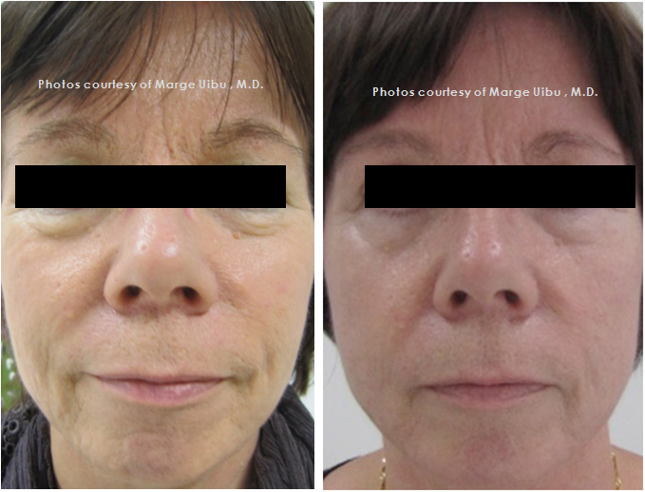
Tightening / lifting
57, Female
Dr. Marge Uibu
Ihoakatemia, Finland
Before Tx
1 month after 1st Tx
Notes:
Age 57. Pre and 2 month after 1 Intracel treatment. There is skin tightening and lifting effect. Wrinkles are reduced and eyebrows are in higher position.

Slide 5
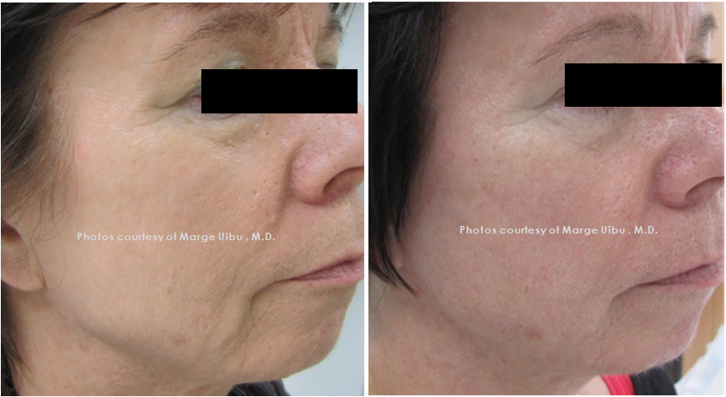
Tightening / lifting
57, Female
Dr. Marge Uibu
Ihoakatemia, Finland
Before Tx
1 month after 1st Tx

Slide 6
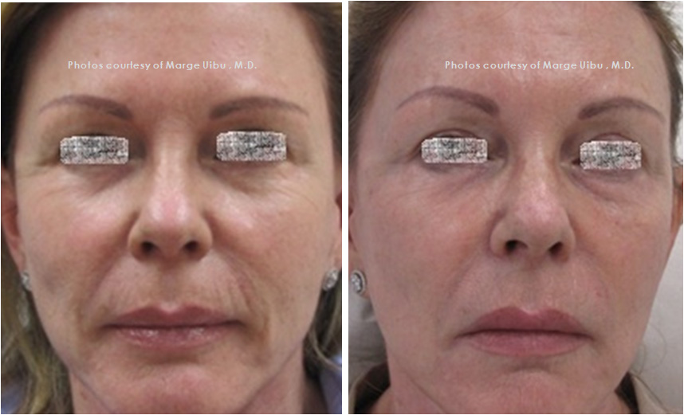
Tightening / lifting
62, Female
Dr. Marge Uibu
Ihoakatemia, Finland
Before Tx
1 month after 1st Tx

Slide 7
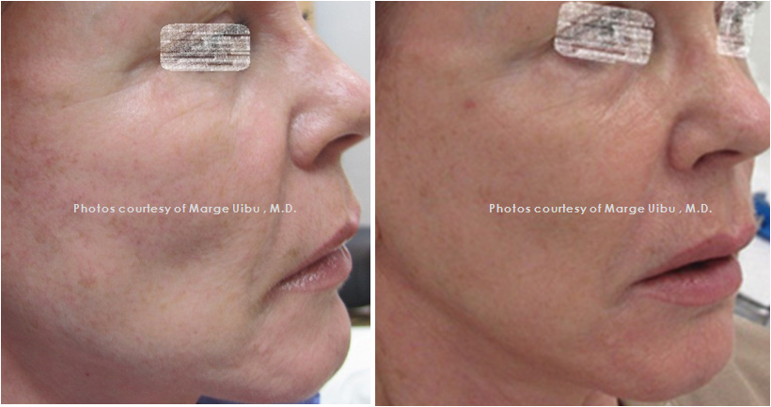
Tightening / lifting
62, Female
Dr. Marge Uibu
Ihoakatemia, Finland
Before Tx
1 month after 1st Tx

Slide 8
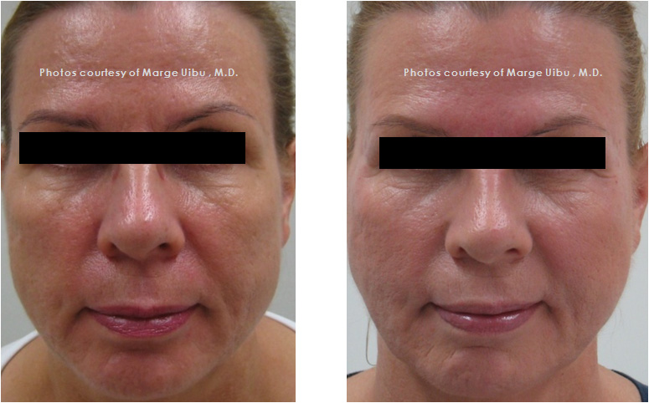
Tightening / lifting
58, Female
Dr. Marge Uibu
Ihoakatemia, Finland
Before Tx
1 month after 1st Tx

Slide 9
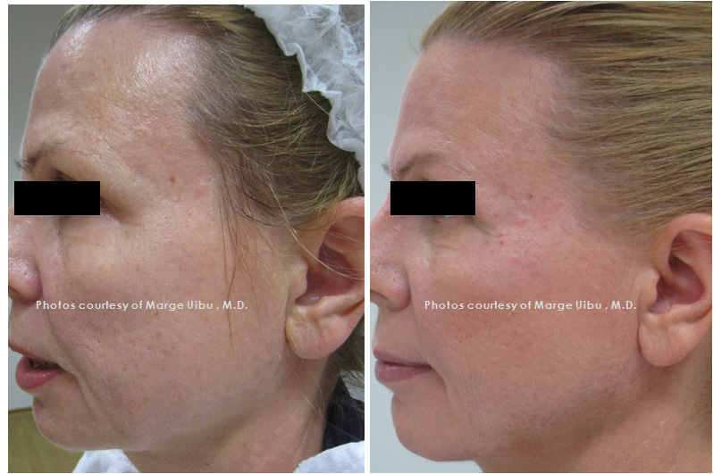
Tightening / lifting
58, Female
Dr. Marge Uibu
Ihoakatemia, Finland
Before Tx
1 month after 1st Tx

Slide 10
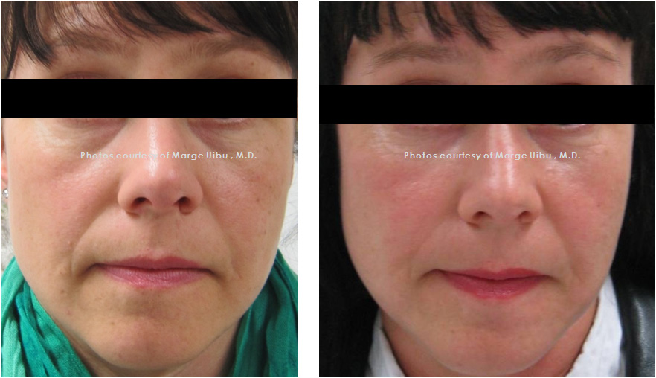
Tightening / lifting
40, Female
Dr. Marge Uibu
Ihoakatemia, Finland
Before Tx
1 month after 1st Tx

Slide 11
Clinical result of INTRAcel
Scar

Slide 12
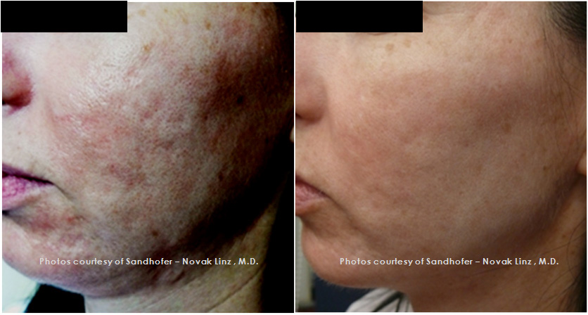
Scar
Dr. Sandhofer – Novak Linz
Before Tx
After Tx

Slide 13
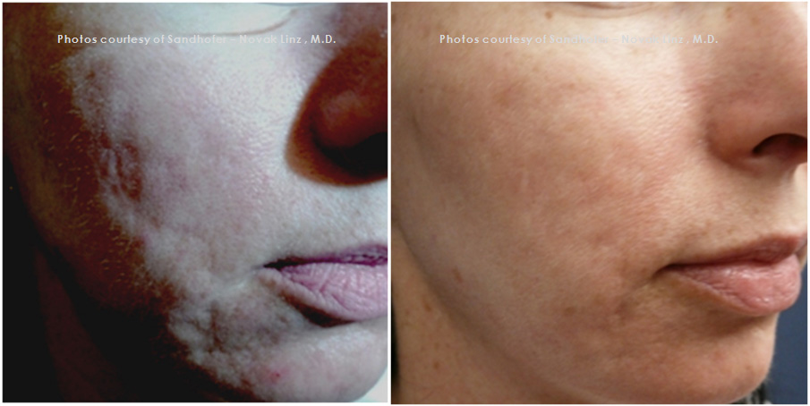
Scar
Dr. Sandhofer – Novak Linz
Before Tx
4 weeks After 2nd Tx

Slide 14
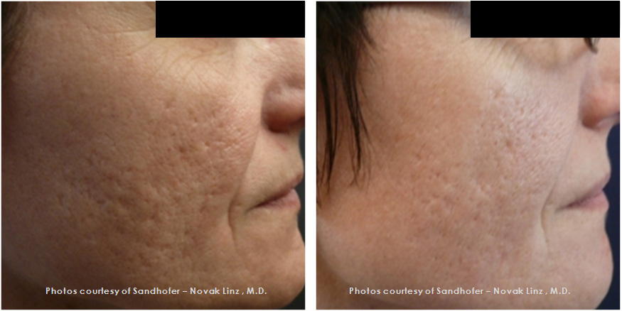
Scar
Dr. Sandhofer – Novak Linz
Before Tx
After Tx

Slide 15
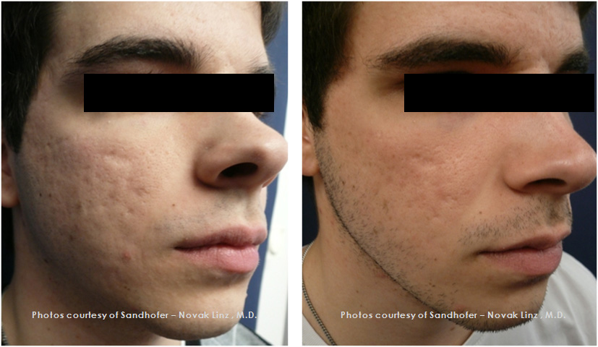
Scar
Dr. Sandhofer – Novak Linz
Before Tx
After Tx

Slide 16
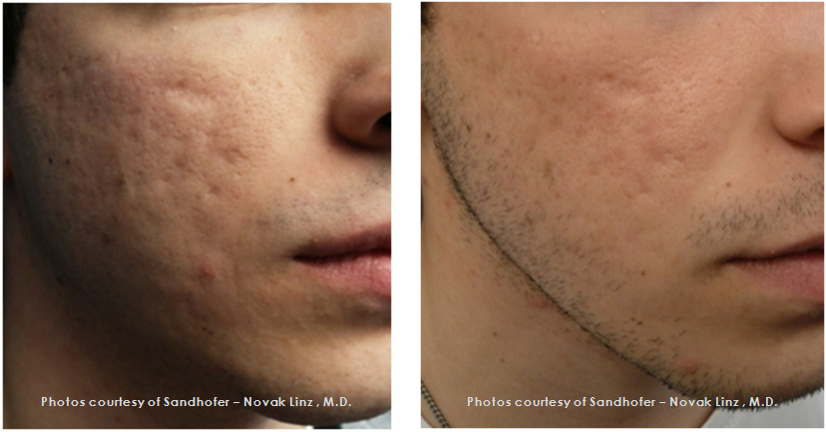
Scar
Dr. Sandhofer – Novak Linz
Before Tx
After Tx

Slide 17
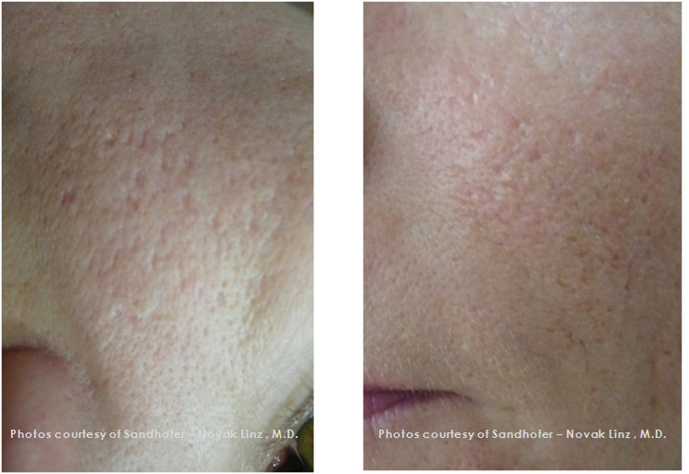
Scar
Dr. Sandhofer – Novak Linz
Before Tx
After Tx : Intracel + CO2

Slide 18
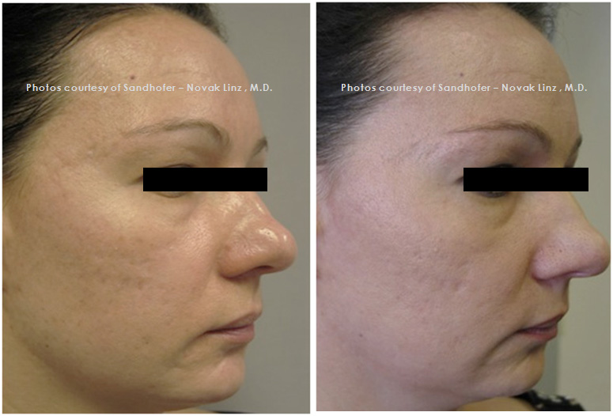
Scar
Dr. Sandhofer – Novak Linz
Before Tx
3 months after Tx

Slide 19
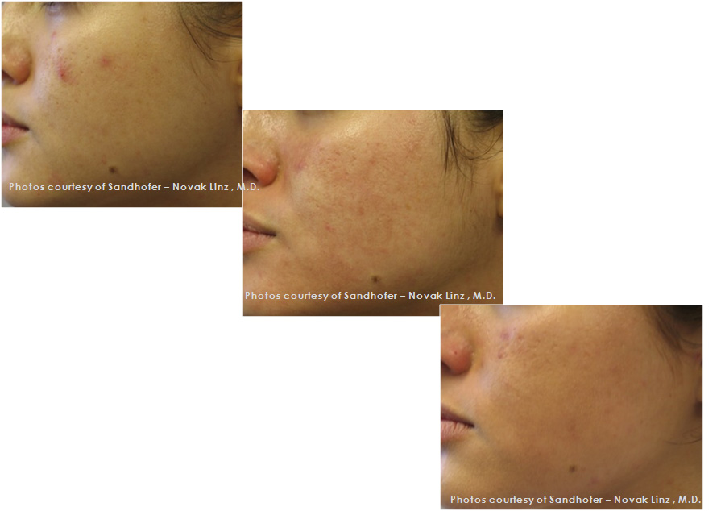
Scar
Dr. Sandhofer – Novak Linz
Before Tx
2 months after Tx
3 months after Tx

Slide 20
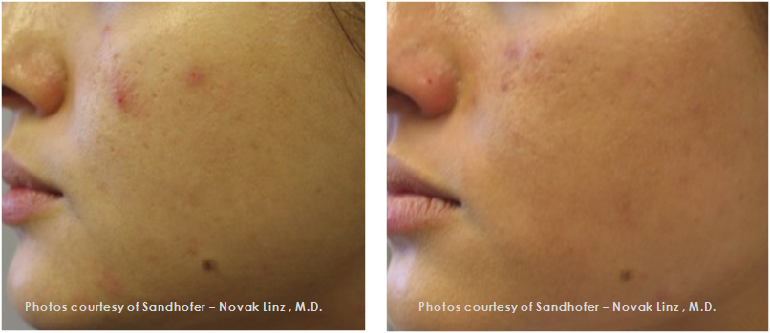
Scar
Dr. Sandhofer – Novak Linz
Before Tx
3 months after Tx

Slide 21
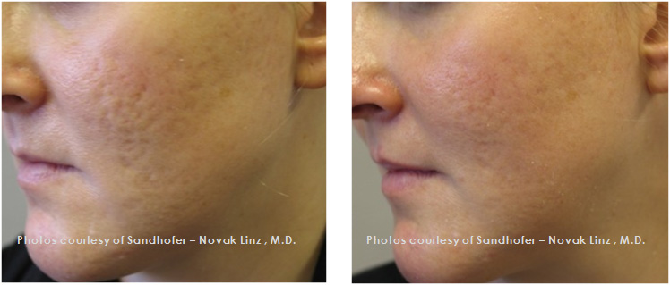
Scar
Dr. Sandhofer – Novak Linz
Before Tx
2 months after Tx

Slide 22
Clinical result of INTRAcel
Striae distensae

Slide 23
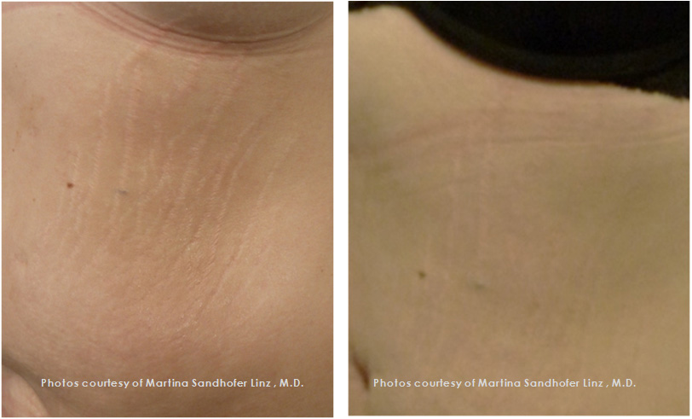
Striae distensae
Dr. Martina Sandhofer Linz
Before Tx
After Tx

Slide 24
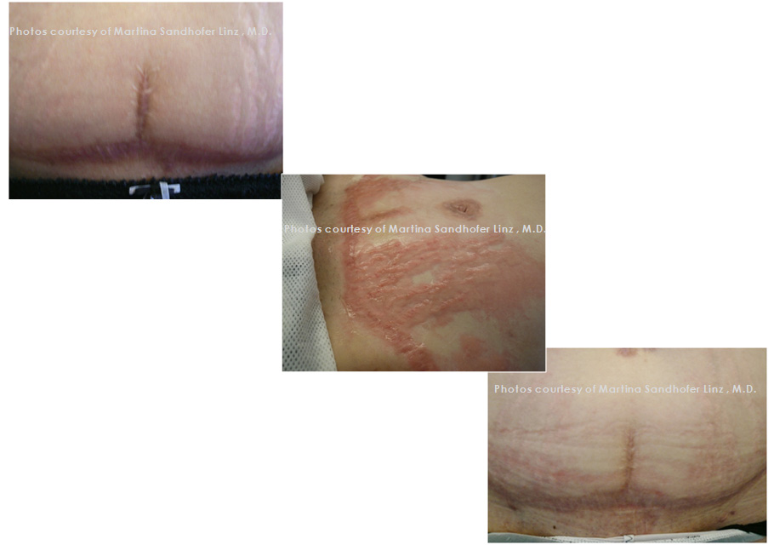
Striae distensae
Dr. Martina Sandhofer Linz
Before Tx
Immediately
After Tx

Slide 25
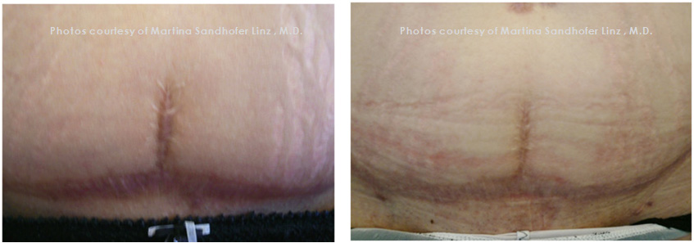
Striae distensae
Dr. Martina Sandhofer Linz
Before Tx
After Tx

Slide 26
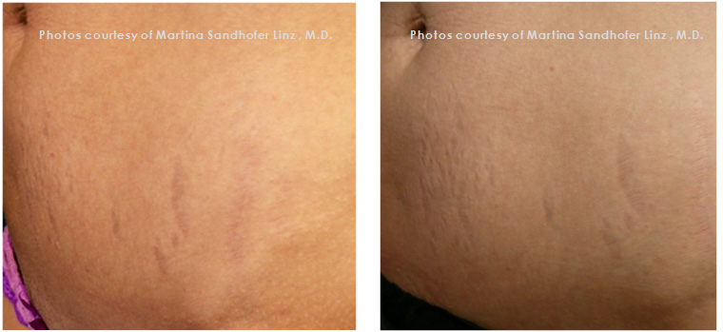
Striae distensae
Dr.Martina Sandhofer Linz
Before Tx
After Tx

Slide 27
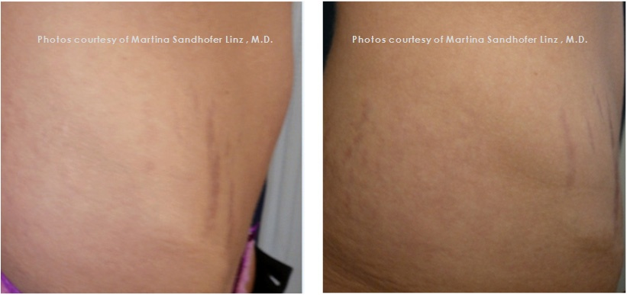
Striae distensae
Dr. Martina Sandhofer Linz
Before Tx
After Tx

Slide 28
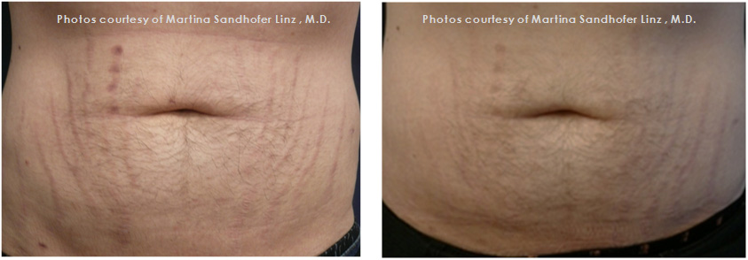
Striae distensae
Dr. Martina Sandhofer Linz
Before Tx
After Tx

