Slide 1
ULTRAcel Q+
Clinical Report
Ver 1.1
Updated 2018.07.26

Slide 2
CASE 1
The twenties, female
Before
Immediately after
4.5mm & 3.0 cartridge
Cheek : 4.5mm-1.1J , Chin : 3.0mm-0.6J / 1st pass → Cheek : 3.0mm-0.7J , Chin : 1.5mm-0.3J / 2nd pass
Total 1 session treatment

Slide 3
CASE 2
The fifties, female
c
Before
Immediately after
4.5mm & 3.0mm & 1.5mm cartridge
Cheek : 4.5mm-1.3J , Chin : 3.0mm-0.9 / 1st pass, → Cheek : 3.0mm-0.8J , Chin : 1.5mm-0.3J / 2nd pass
Forehead : 1.5mm-0.4J 1 pass Malar Area : 3.0mm-0.8J 1st pass → 1.5mm-0.4J 2nd pass
Total 1 session treatment

Slide 4
CASE 3
The fifties, female
Before
Immediately After
4.5mm & 3.0mm & 1.5mm cartridge
Cheek : 4.5mm-1.3J , Chin : 3.0mm-0.9 / 1st pass, → Cheek : 3.0mm-0.8J , Chin : 1.5mm-0.3J / 2nd pass
Forehead : 1.5mm-0.4J 1 pass Malar Area : 3.0mm-0.8J 1st pass → 1.5mm-0.4J 2nd pass
Total 1 session treatment

Slide 5
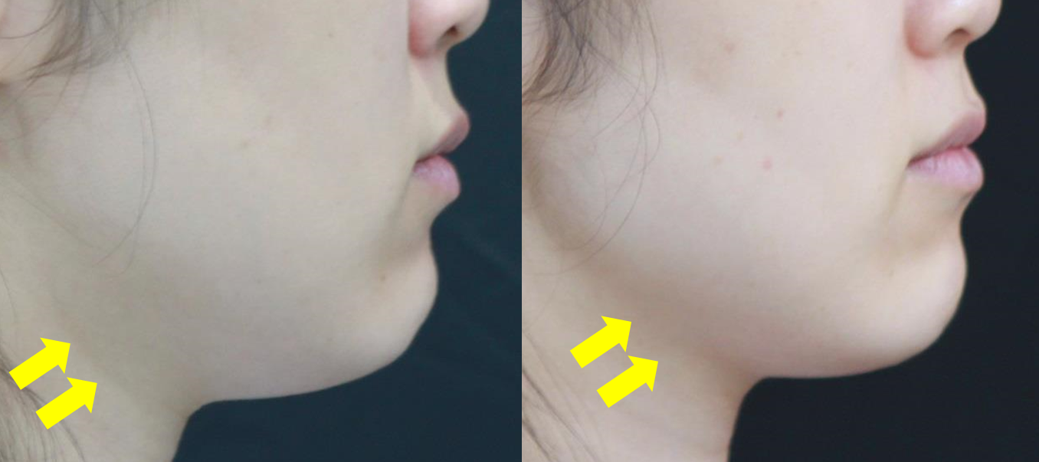
CASE 4
The thirties, female
Before
3 month after 1st treatment
4.5mm & 3.0mm cartridge
Q 4.5 - 0.9J, 1.5mm spacing , 200shots , 1st pass , Q 3.0 - 0.7J,1.5mm spacing, 200shots, 2nd pass
Total 1 session treatment

Slide 6
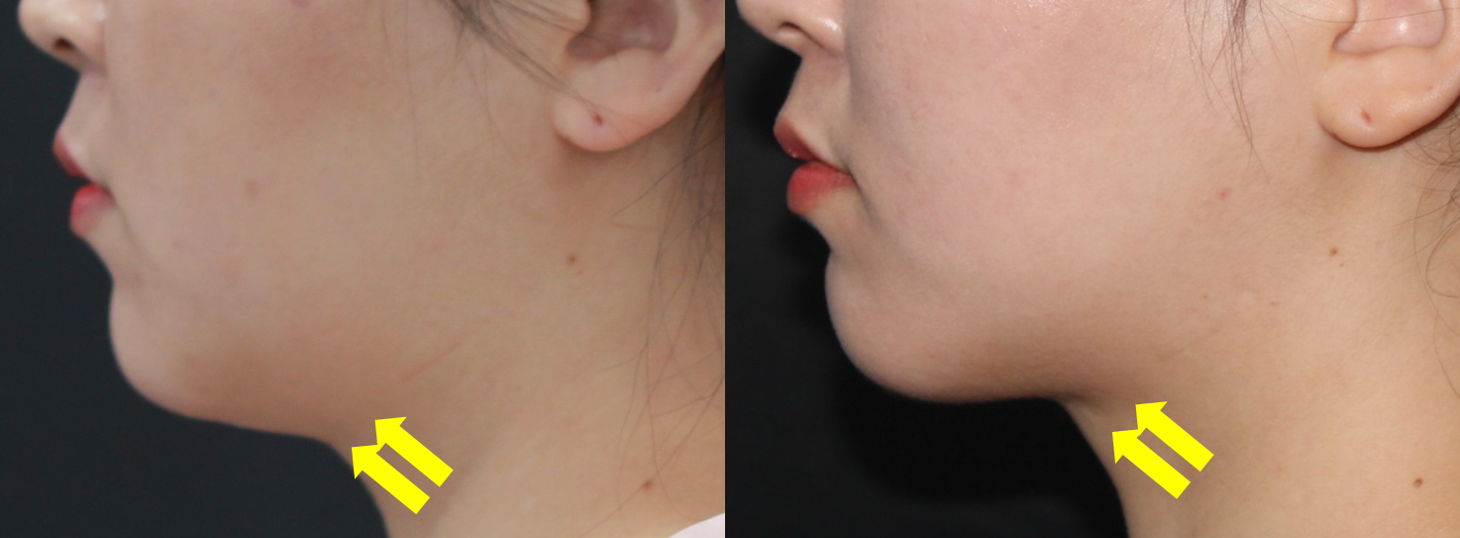
CASE 5
The thirties, female
Before
3 month after 1st treatment
4.5mm & 3.0mm cartridge
Q 4.5 - 0.9J, 1.5mm spacing , 200shots , 1st pass , Q 3.0- 0.8J, 1.5mm spacing, 200shots, 2nd pass
Total 1 session treatment

Slide 7
CASE 6
The sixties, female
Before
6 weeks after 3rd treatment
2.0mm cartridge
0.3J, 1.5mm spacing, 30 shots, 3 passes ,
Total 3 session treatment

Slide 8
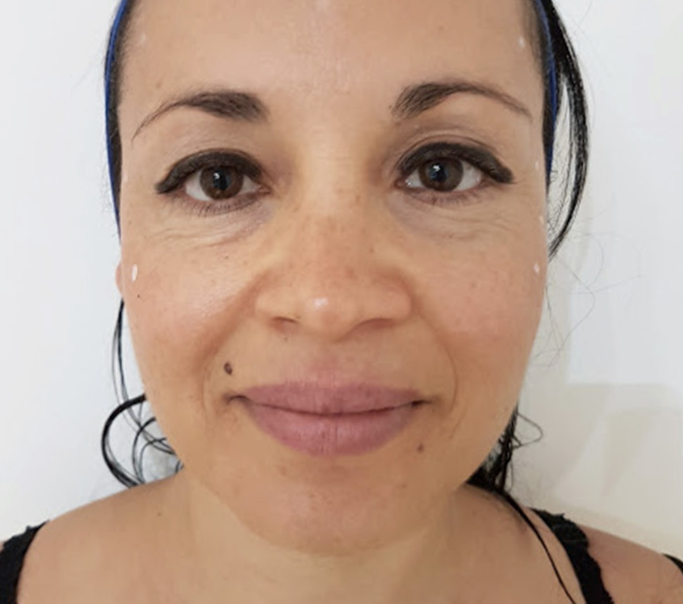
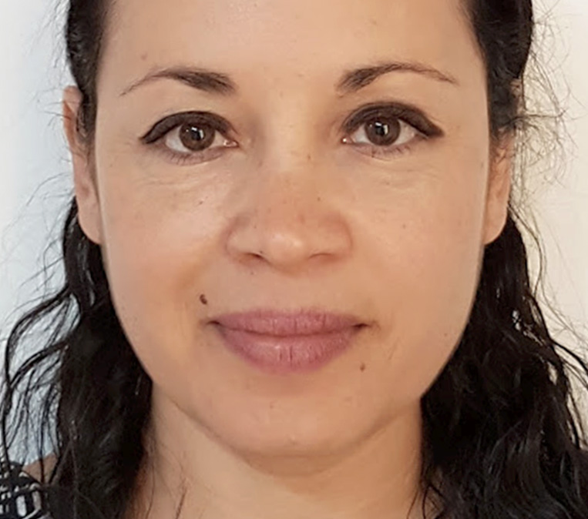
CASE 7
The forties, female
Before
6 weeks after 2nd treatment
4.5mm,3.0mm, 2.0mm & 1.5mm cartridge
Cheek : 4.5mm-1.1J , Chin : 3.0mm-0.7J / 1st pass, → Cheek : 3.0mm-0.8J , Chin : 1.5mm-0.3J / 2nd pass
Periorbital : 2.0mm-0.3J 1 pass Malar Area : 3.0mm-0.8J 1st pass → 1.5mm-0.4J 2nd pass
Total 2 session treatment

Slide 9
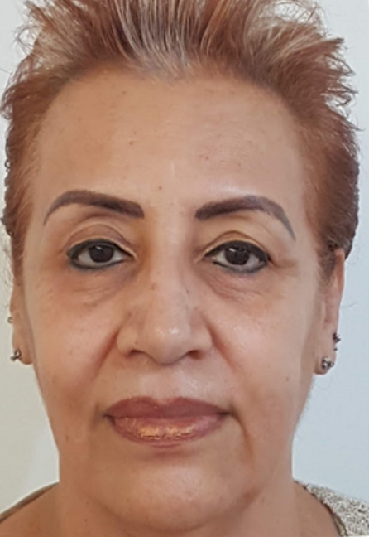
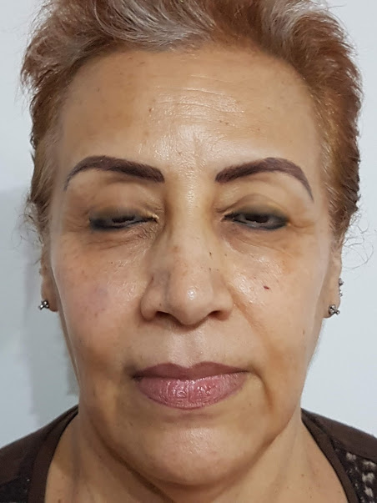
CASE 8
The fifties, female
Before
6 weeks after 2nd treatment
4.5mm, 3.0mm, 2.0mm & 1.5mm cartridge
Cheek : 4.5mm-1.1J , Chin : 3.0mm-0.7J / 1st pass, → Cheek : 3.0mm-0.8J , Chin : 1.5mm-0.3J / 2nd pass
Periorbital : 2.0mm-0.3J 1 pass Forehead : 1.5mm-0.4J 1 pass
Total 2 session treatment

Slide 10
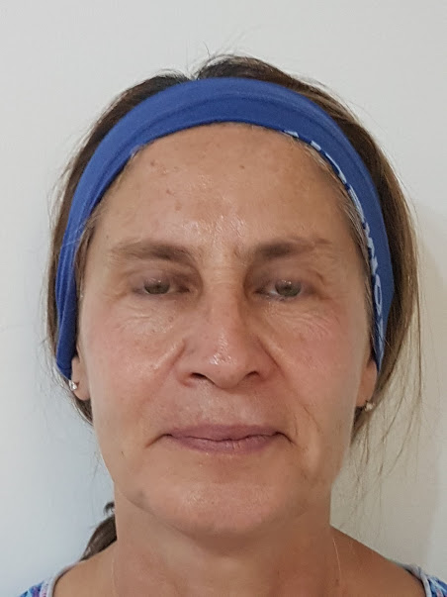
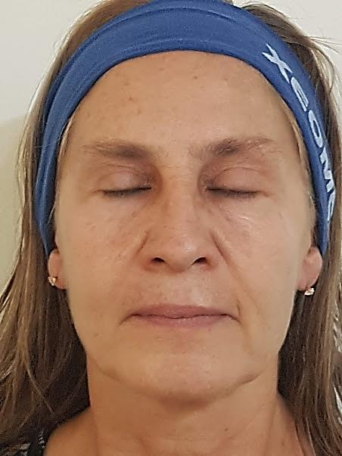
CASE 9
The forties, female
Before
6 weeks after 2nd treatment
4.5mm, 3.0mm, 2.0mm & 1.5mm cartridge
Cheek : 4.5mm-1.1J , Chin : 3.0mm-0.7J / 1st pass, → Cheek : 3.0mm-0.8J , Chin : 1.5mm-0.3J / 2nd pass
Periorbital : 2.0mm-0.3J 1 pass Forehead : 1.5mm-0.4J 1 pass
Total 2 session treatment

Slide 11
CASE 10
The thirties, female
Before
2 months after 1st treatment
2.0mm cartridge
0.3J, 1.5mm spacing, 30 shots, 3 passes
Total 1 session treatment

